Slide 1

AIRPLANE TICKET BOOKING
Submitted by :
ANJAN SHAH
PRABHJOT SINGH
SAVITA SHARMA
KAMINI BANWALA

Slide 2

Contents
Project Overview
Business Objective
Design Flow
ER Diagram
Star Schema
ETL
Dimensional hierarchy

Slide 3
Project Overview
Airplane Ticket Framework contains the bits of knowledge in regarding flight details, fare tariffs, passenger reservations and ticket information. An airline inventory contains all the flights that are flying, the available seats on each, the flying time of the respective flight. The system also have a feature where we have info about which planes include accessible seats.
ATS) is a modernized framework used to store and recover data and manage exchanges related to air travel.

Slide 4

Business Objectives
The fundamental goal of this task is to help the traveller with reserving flight spot.
The structure will empower clients to find all of the flights fulfilling measures, for example, date, time, seat type, cost, beginning and objections of flight.
The client can book a reservations and save its detail for future reference.

Slide 5
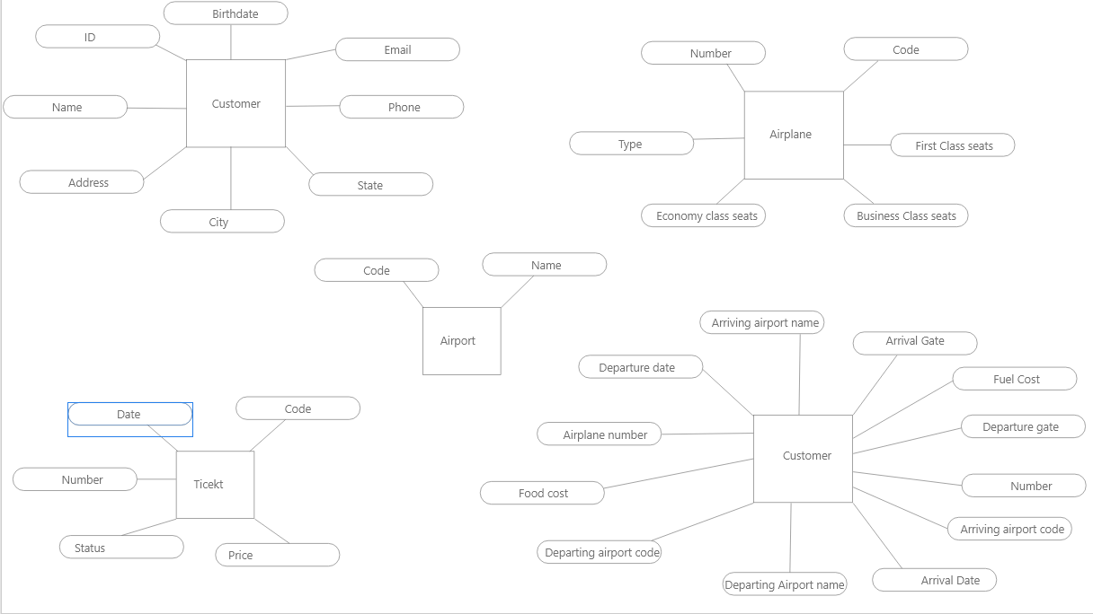
ER Diagram Wireframe

Slide 6

E-R Model

Slide 7
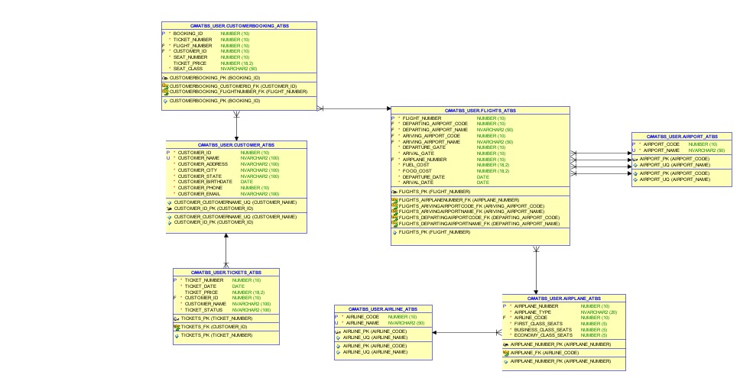

Slide 8
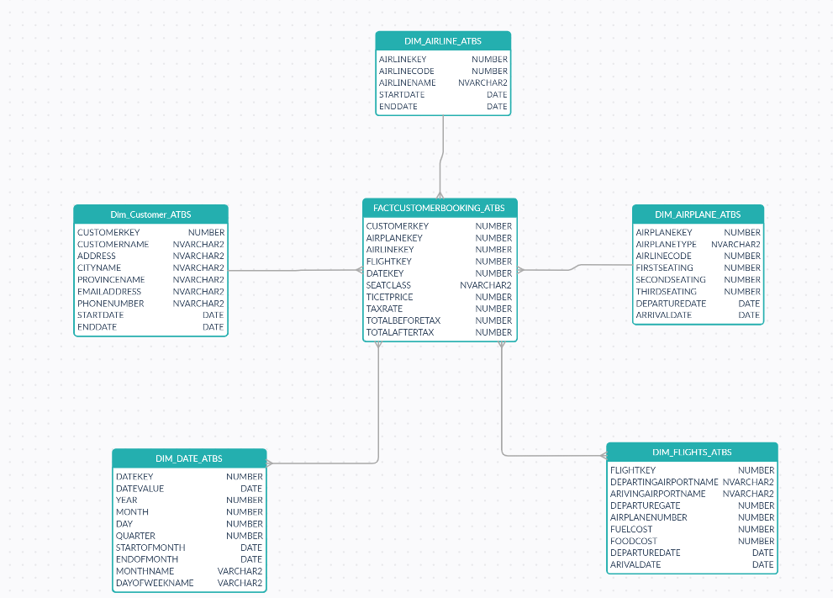
Star Schema

Slide 9
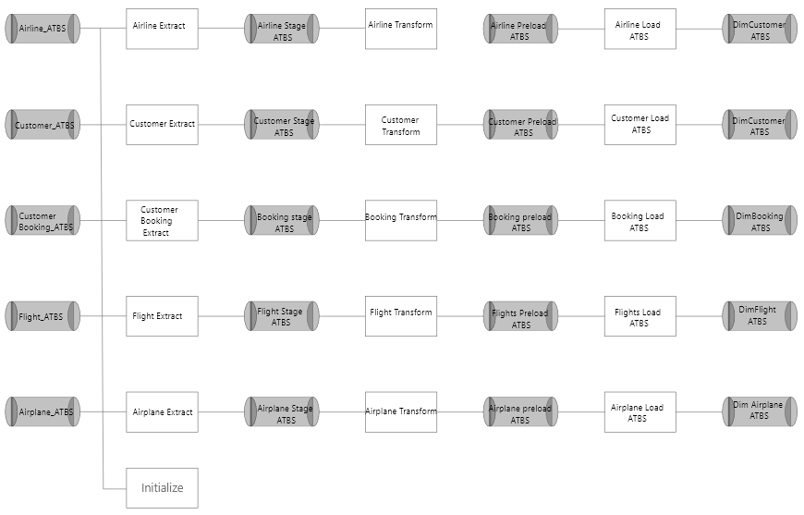
ETL Diagram

Slide 10
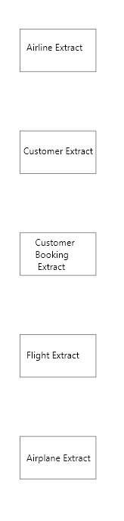
Extract
We utilised 5 extract functions connected to the appropriate tables and 5 staging tables, totaling 5 execute SQL task functions.
Customer Stage, Airplane Stage, Customer Booking, Flights, and Airline Extract are staging tables.
SQL Server has been used to create the stored procedures for extracting the data that will be further fed into the appropriate staging tables.

Slide 11
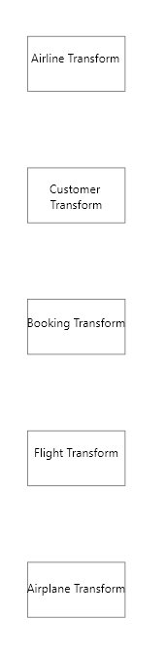
Transform
According to the right structure/storage format of the dimension tables established in the data warehouse, the data is processed and transformed.
To store the customer, their reservations, and their flight based on new insertion, deletion, or modifications, the 4 dimension tables were developed as a SCD two-level.
The preload tables were transformed and loaded using stored procedures..

Slide 12
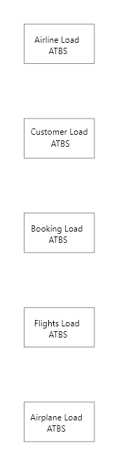
Load
The four dimension tables (Customer Dimension, Airplane Dimension, Flights Dimension, and Airline Dimension) and fact tables were filled with the converted data (FactCustomer Booking).
These data marts and fact tables will assist in meeting our technical requirements and in achieving the goal of using SQL Server Analysis's Services to analyse the data (S.S.A.S.)
These dimension and information tables will be used to create and shape the cube.

Slide 13
Sample of an Extract Procedure

Slide 14
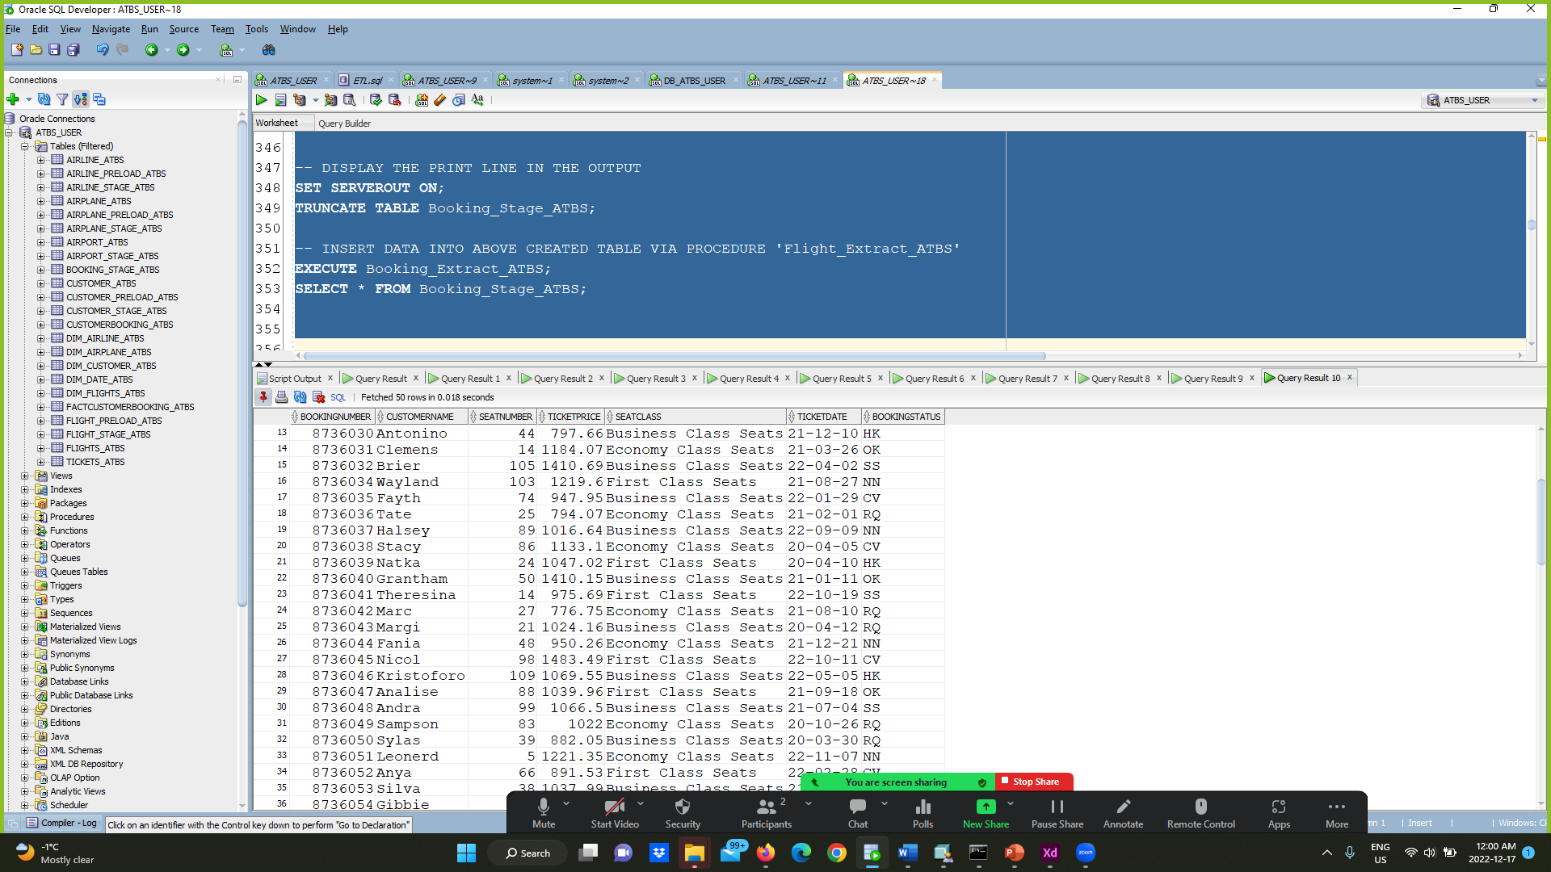

Slide 15
Sample of a Transform Procedure

Slide 16
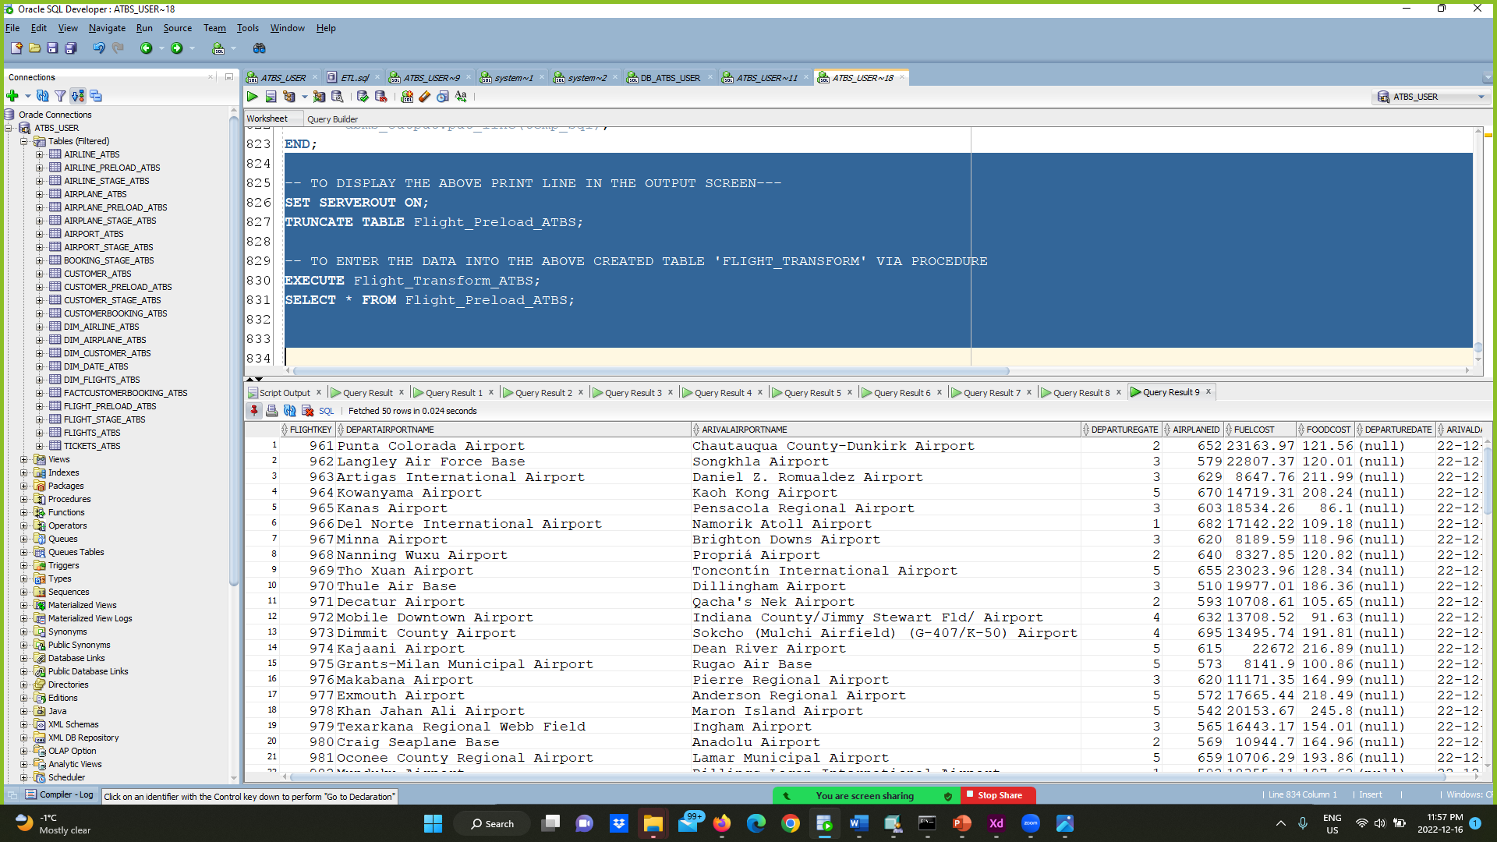

Slide 17
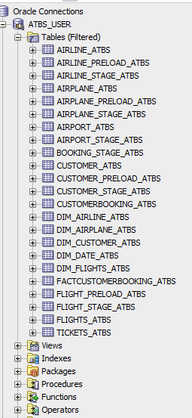
Tables Created

Slide 18
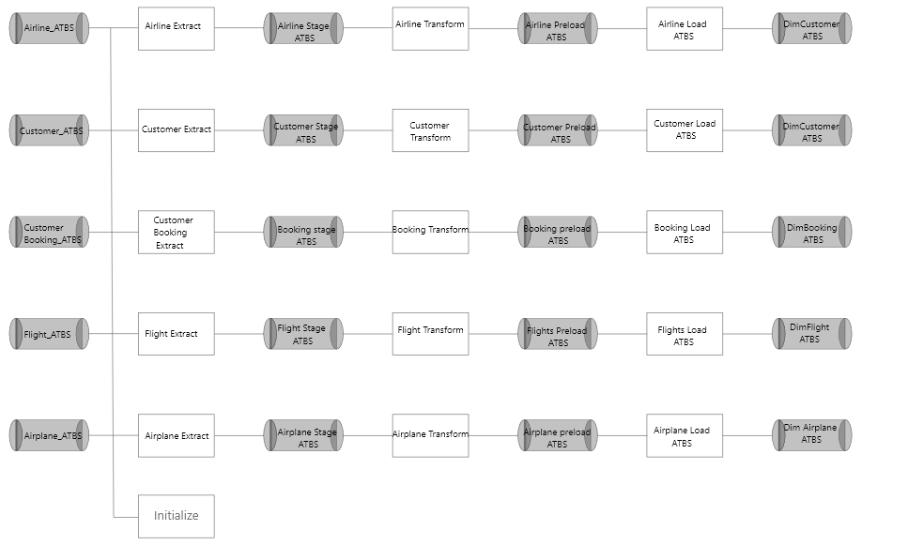
Dimensional Hierarchies

Slide 19
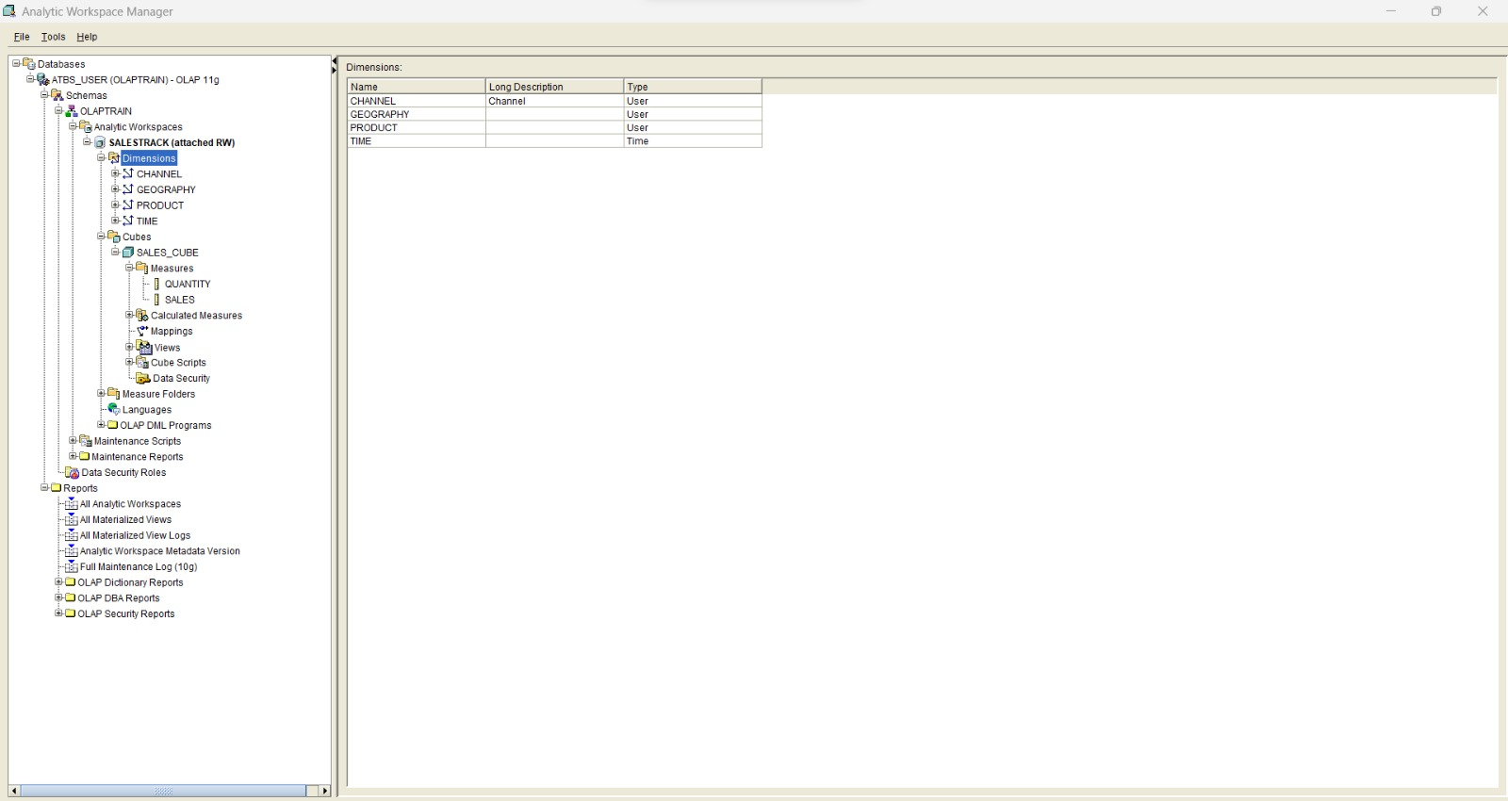
List of Dimensions

Slide 20
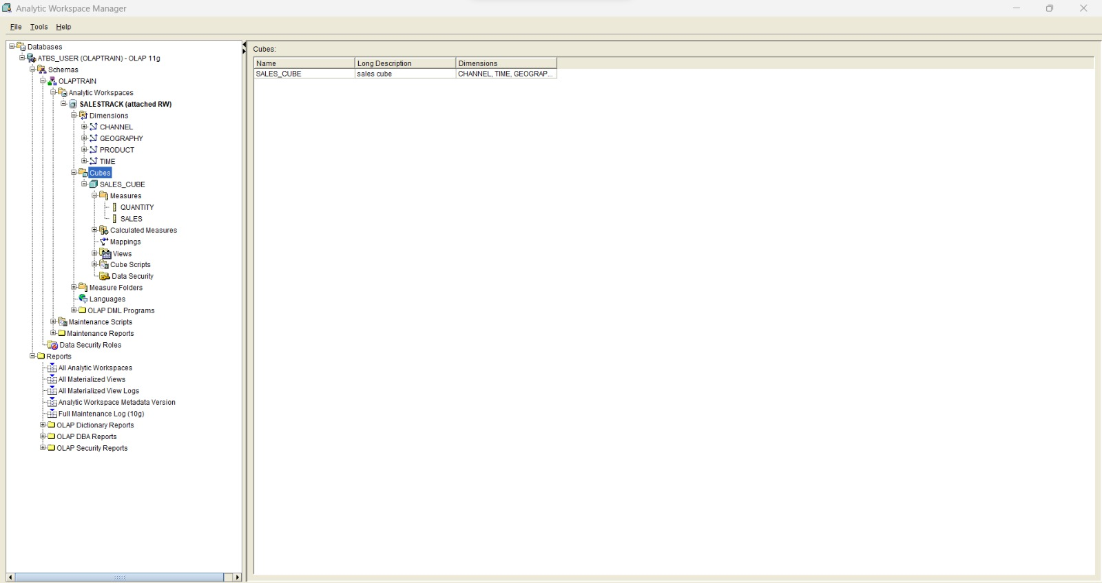
List of Cubes

Slide 21
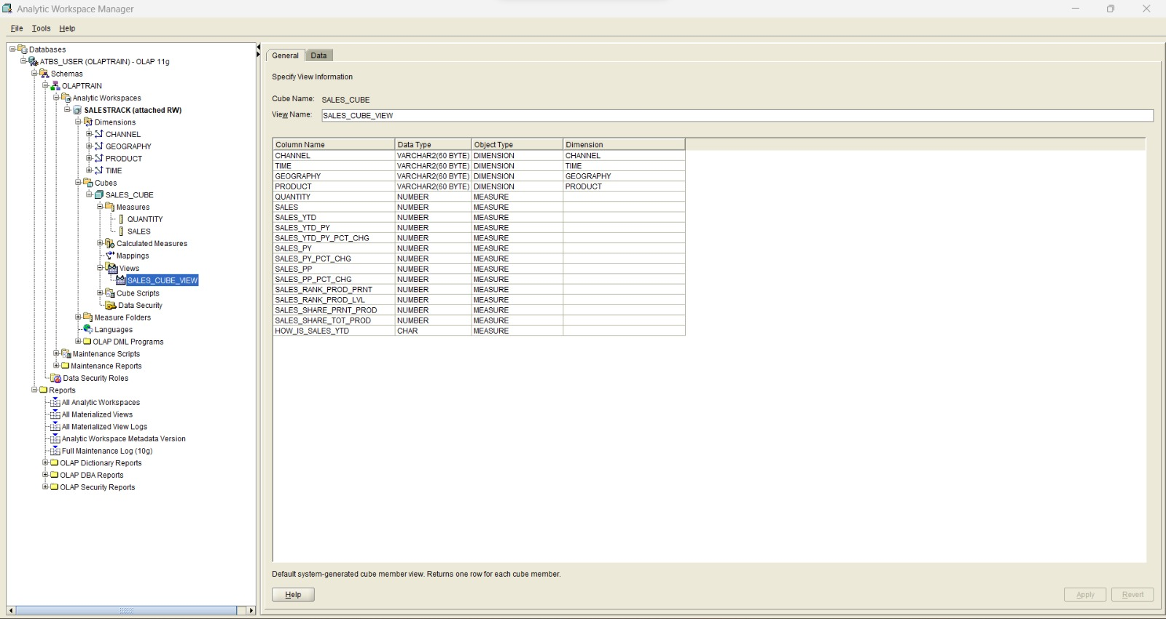
Building OLAP Cube

Slide 22
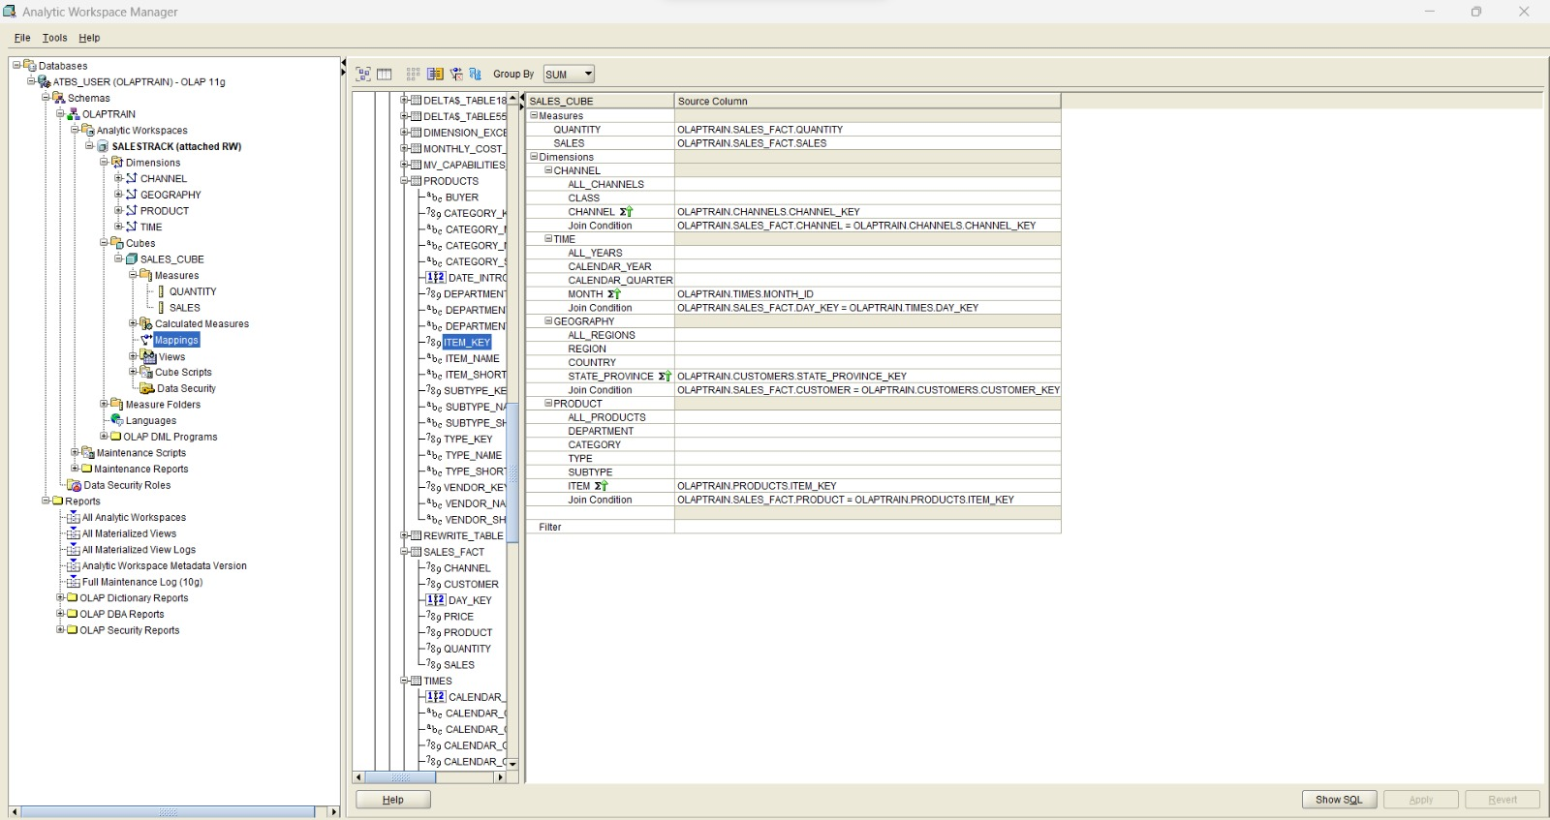
Mapping Cubes to Relational Sources

Slide 23
Checking View Details

Slide 24
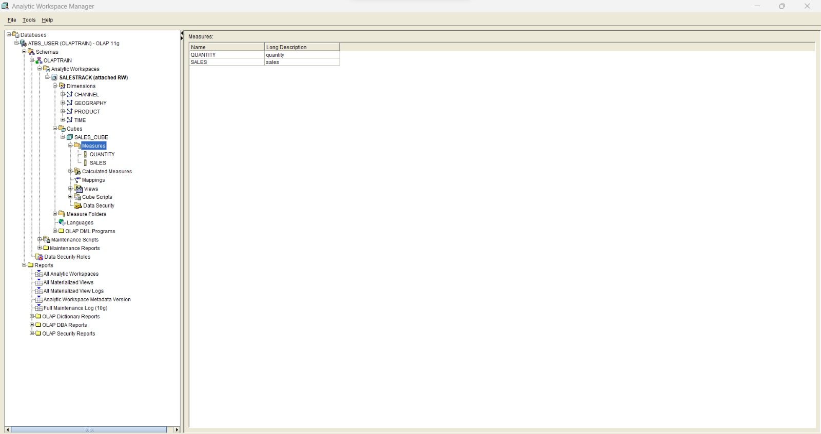
Creating and Viewing Measures

Slide 25
Results for OLAP

Slide 26
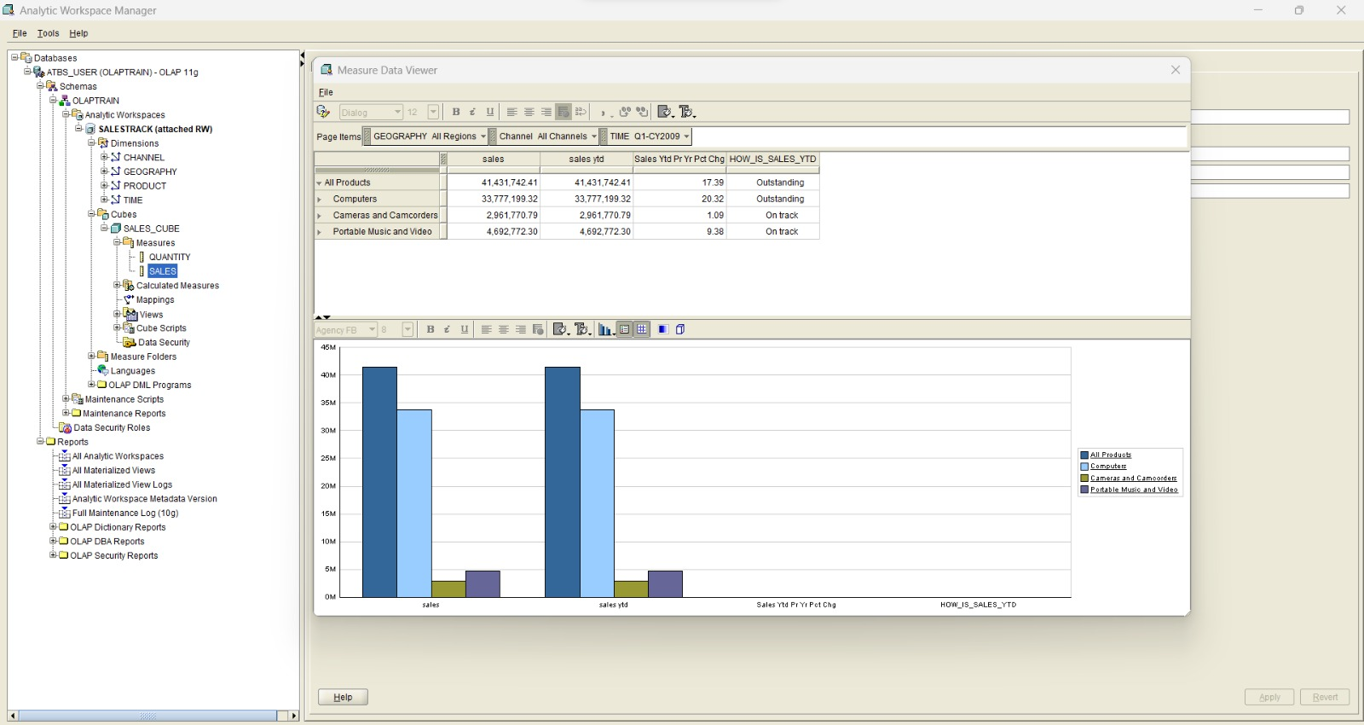
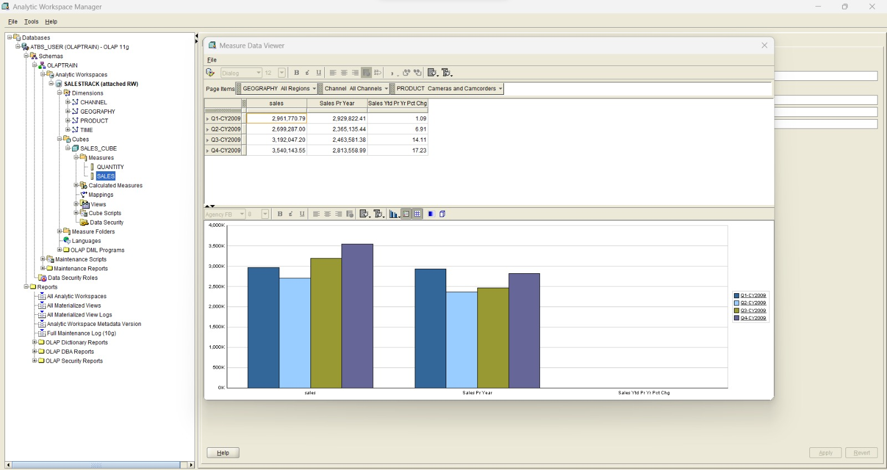

Slide 27
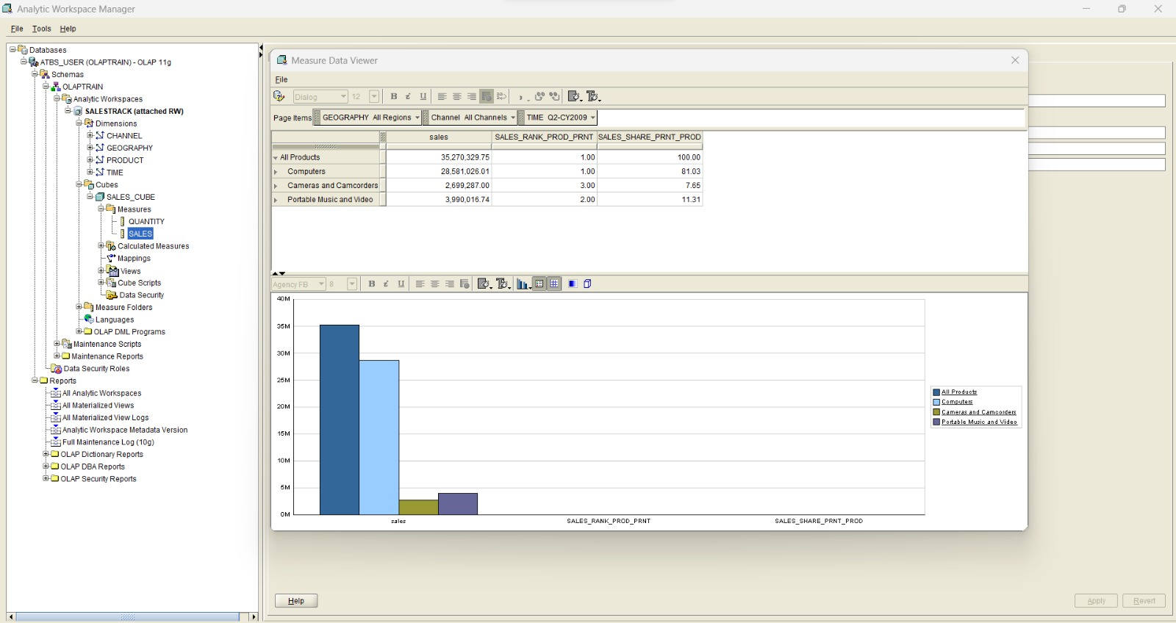
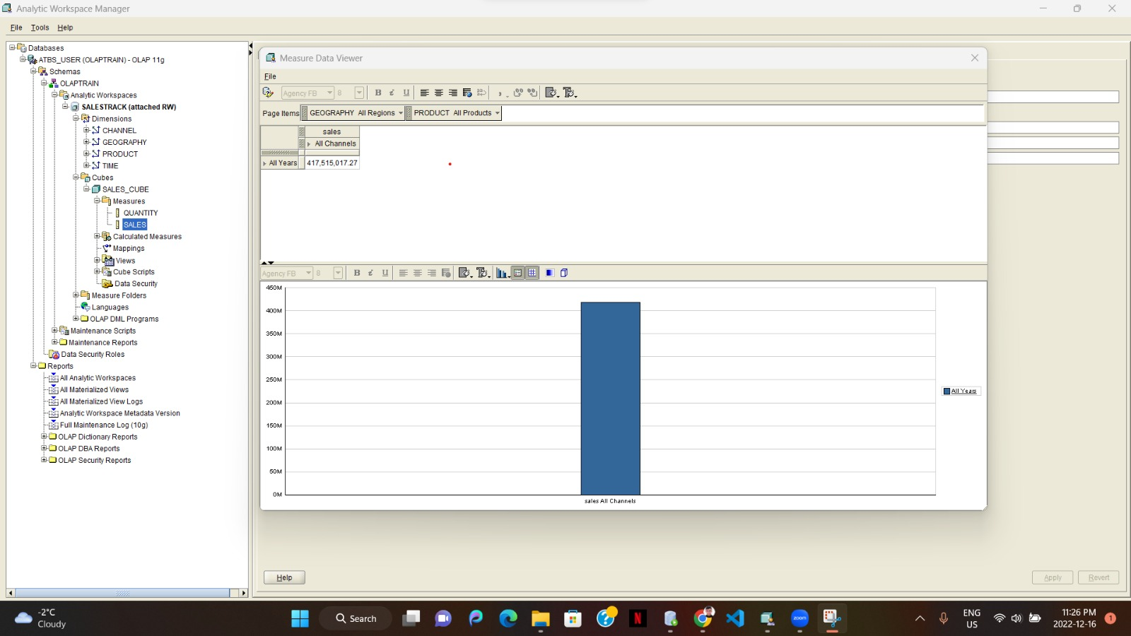

Slide 28

Thank you

